Slide 1
Power bi
Akshata Gedam

Slide 2

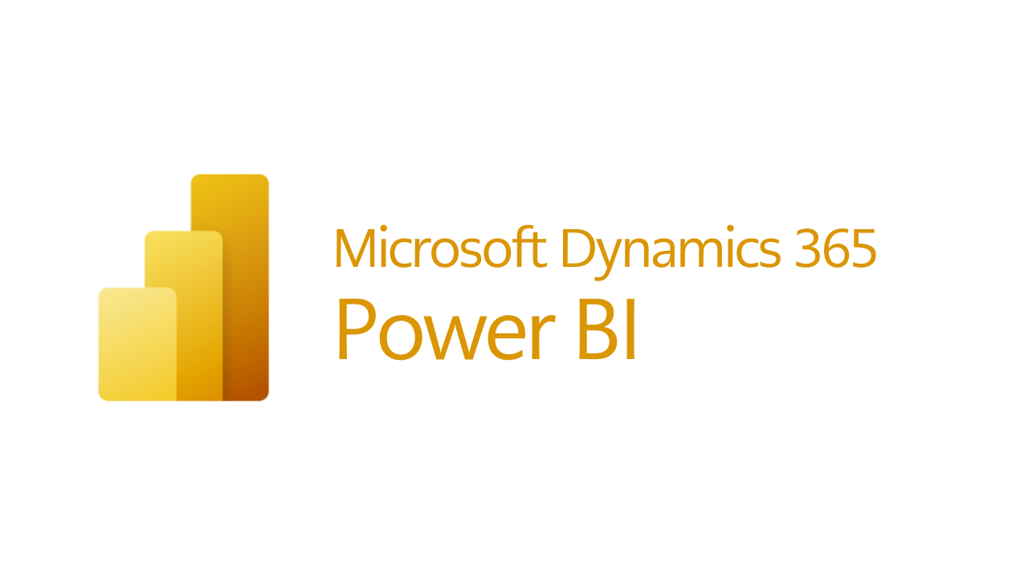
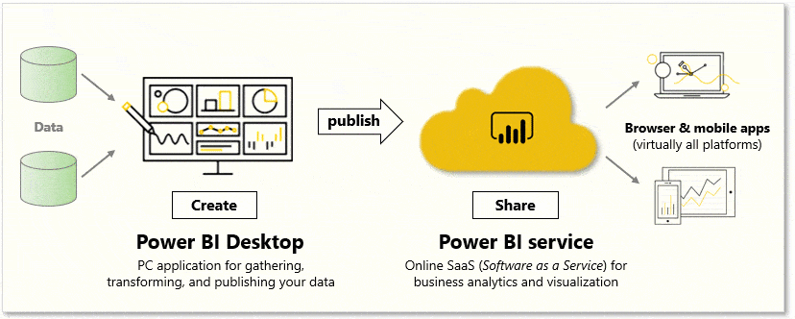
What is power bi
Power BI is a Microsoft's self-service BI platform for both on premise and cloud-based data.
It provides business users with tools for aggregating, visualizing and sharing data.
Power BI is used to built Reports & Dashboards
Types of Power BI services available :
Power BI Desktop
Power BI Web Services
Power BI App

Slide 3
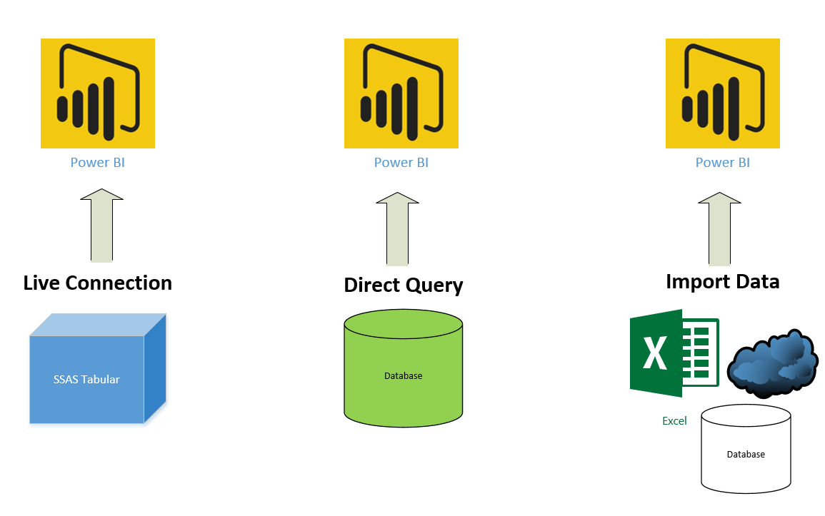

Data connectivity mode…

Slide 4

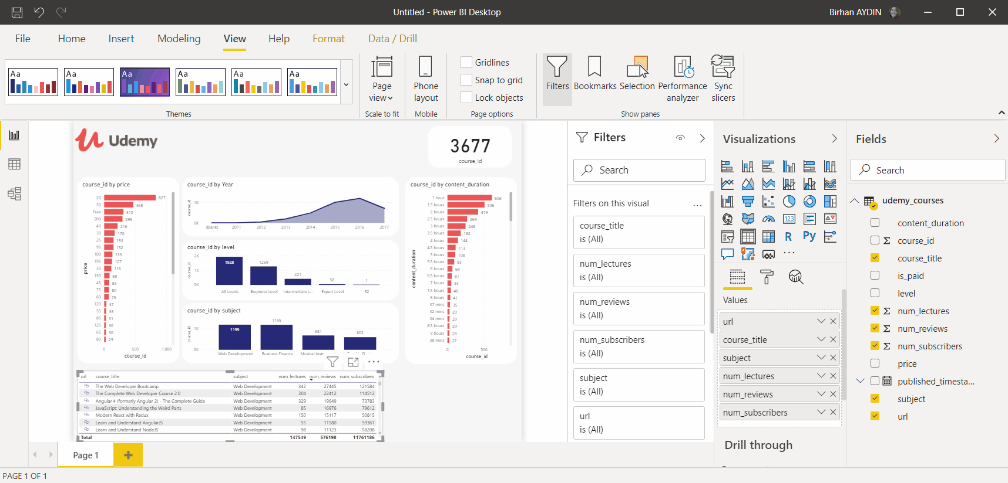
panels…

Slide 5
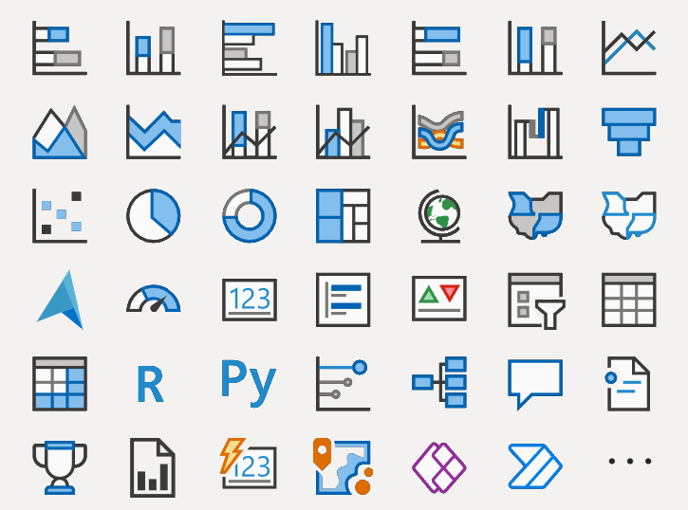
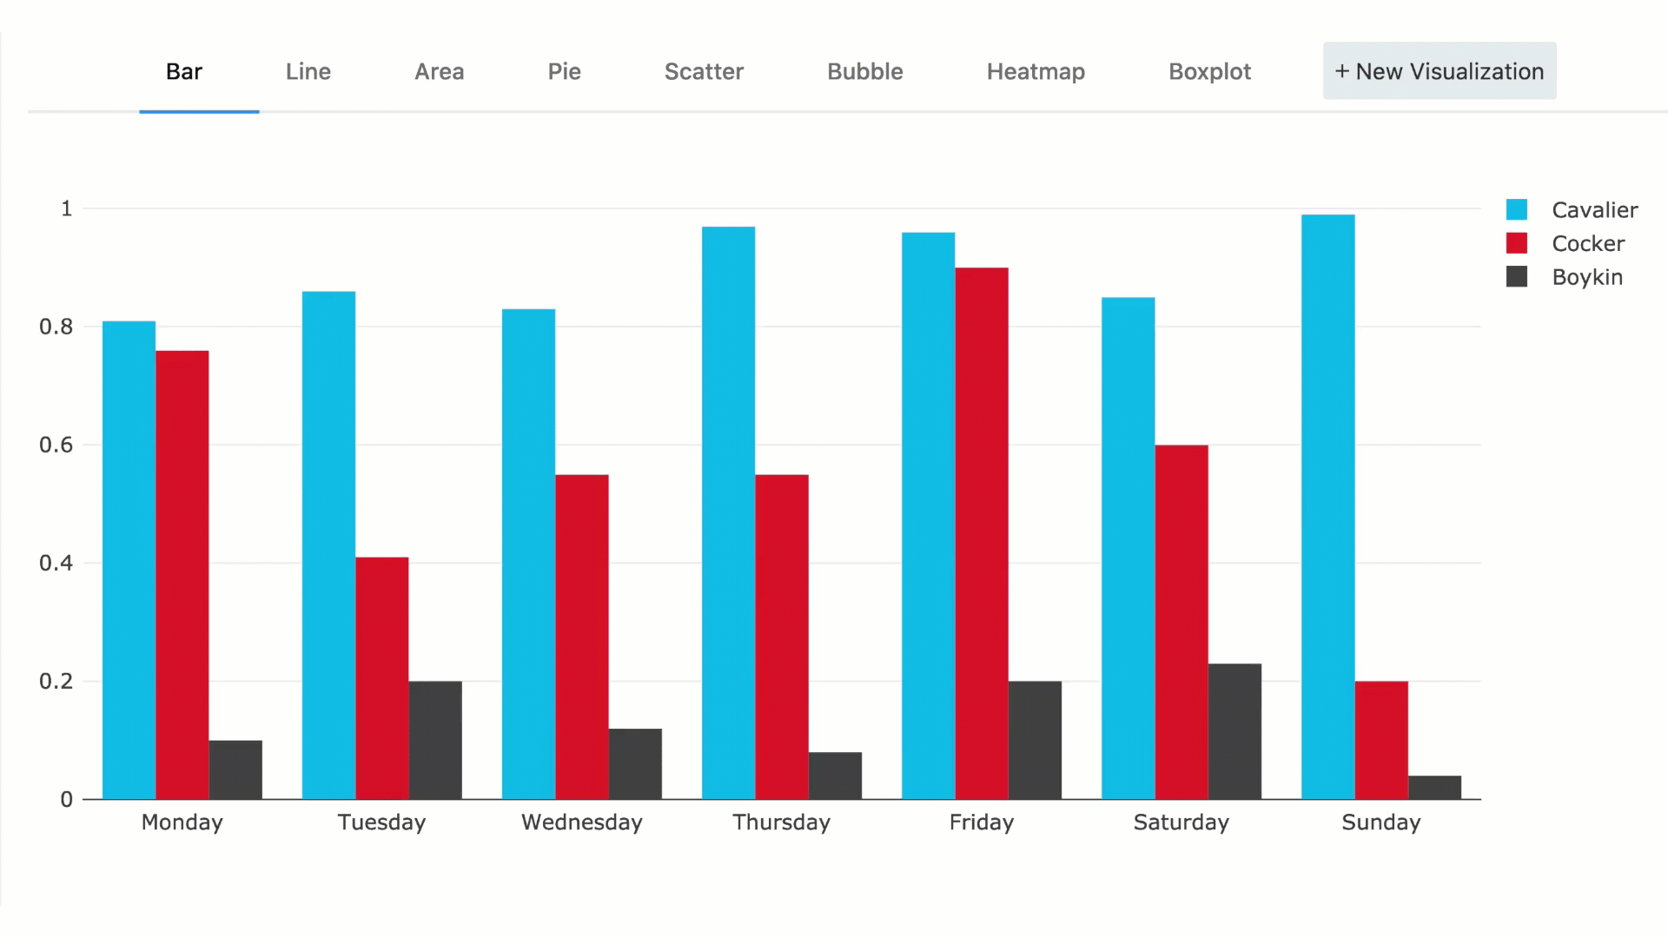
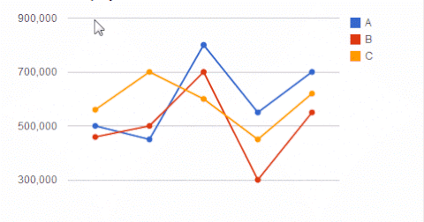
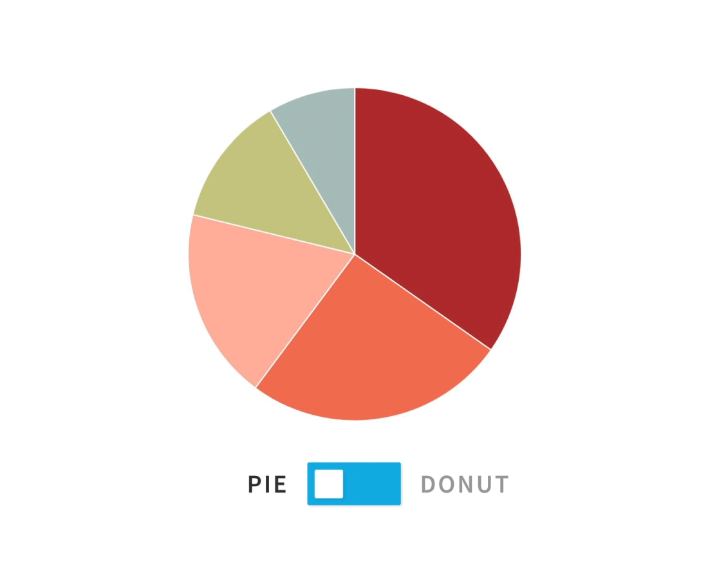
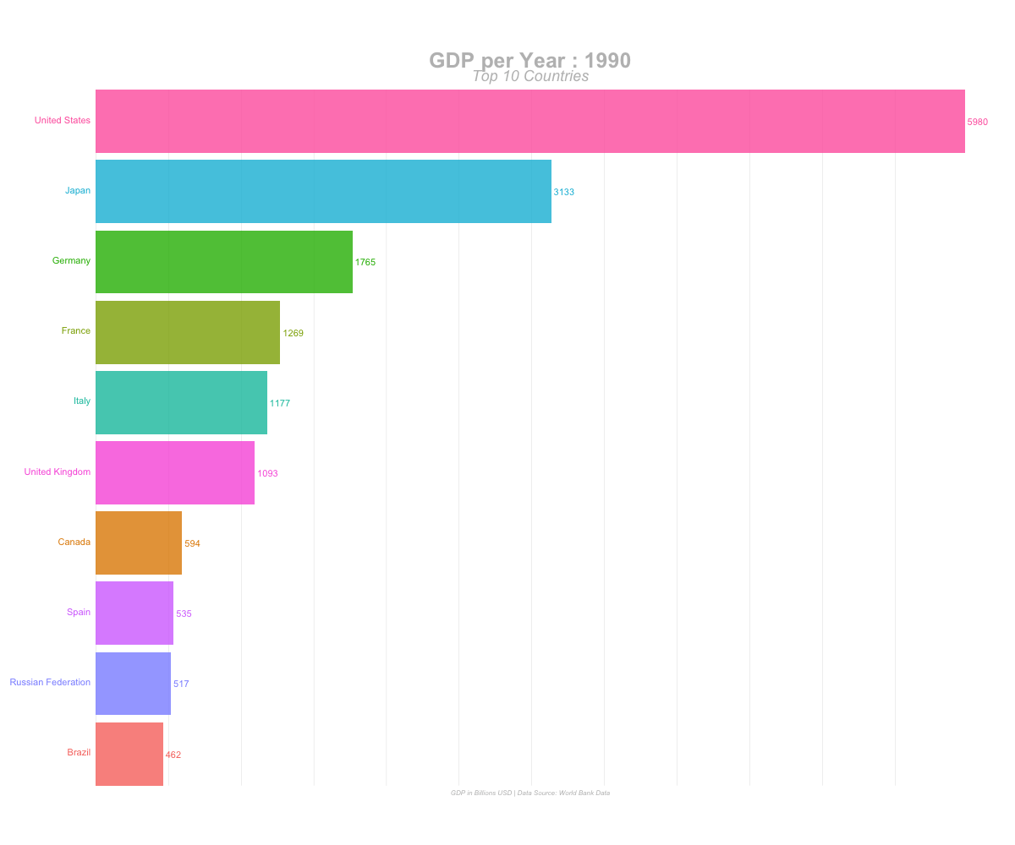
Basic & advance charts…

Slide 6
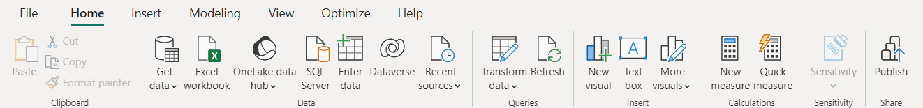
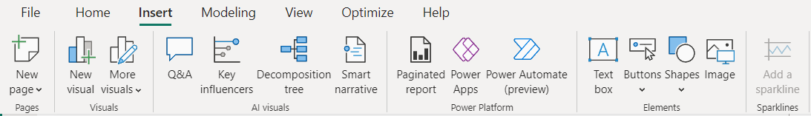
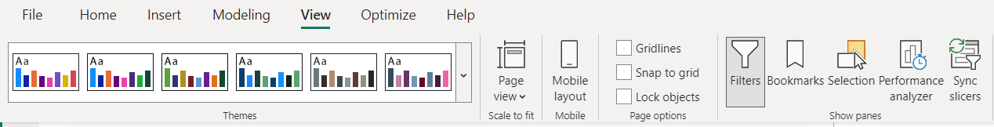
Ribbon of power bi
Home
Insert
View

Slide 7
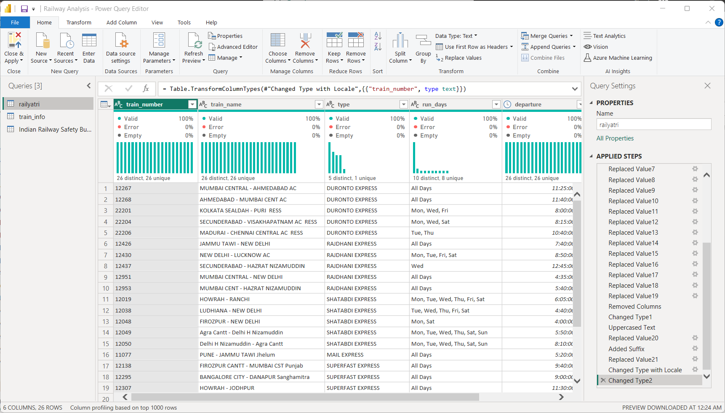
Power query editor

Slide 8
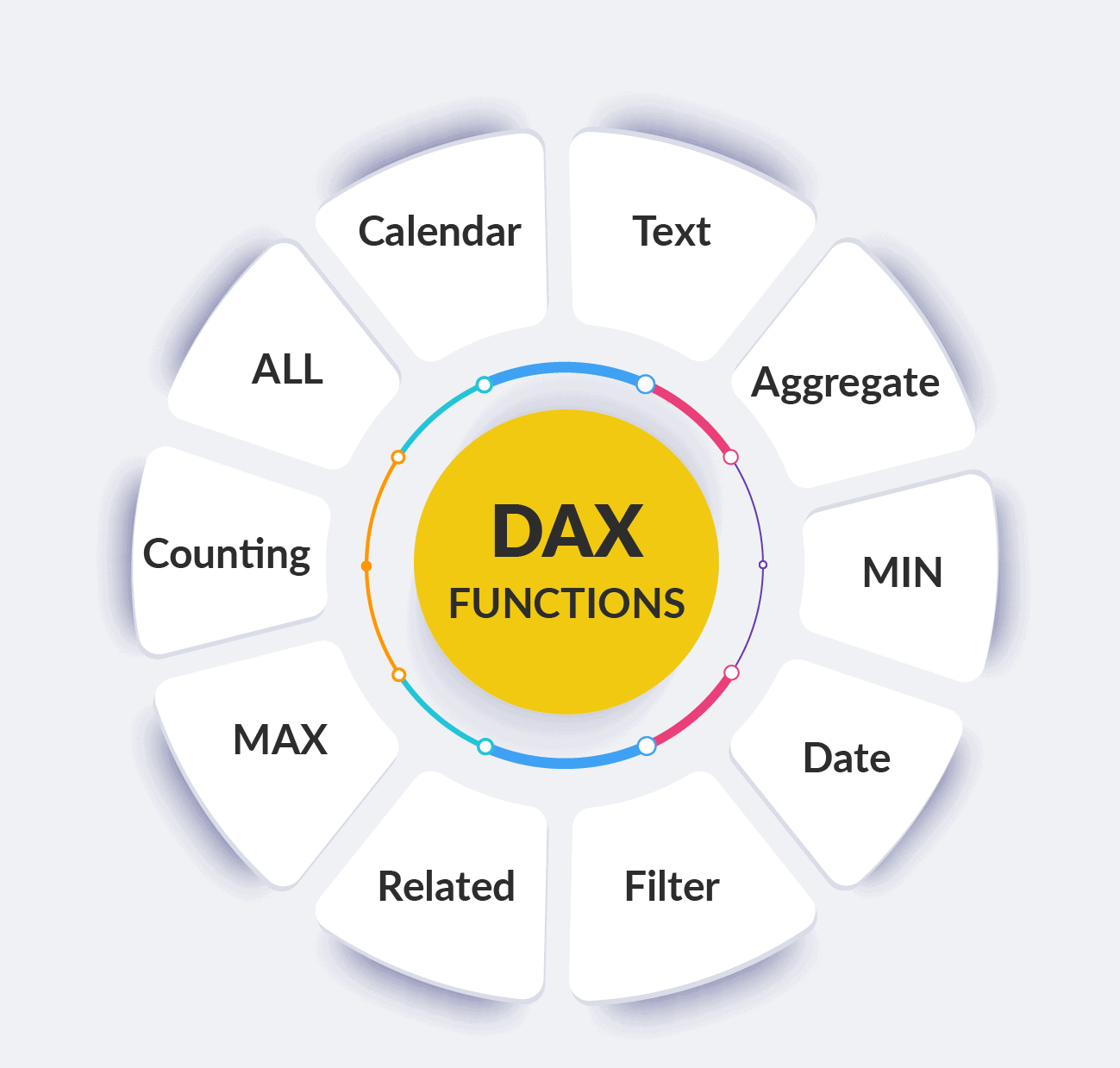
Data analysis expressions in power bi

Slide 9
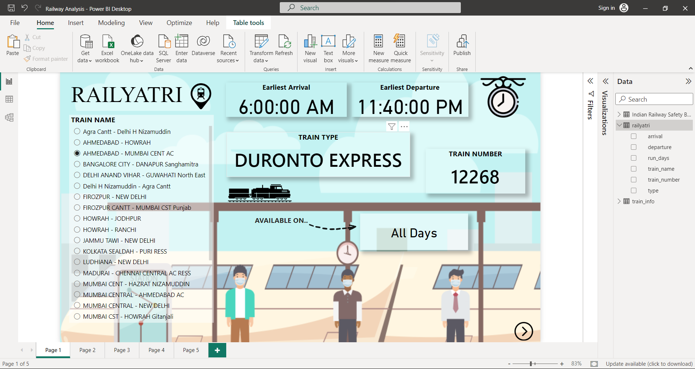
My project

Slide 10
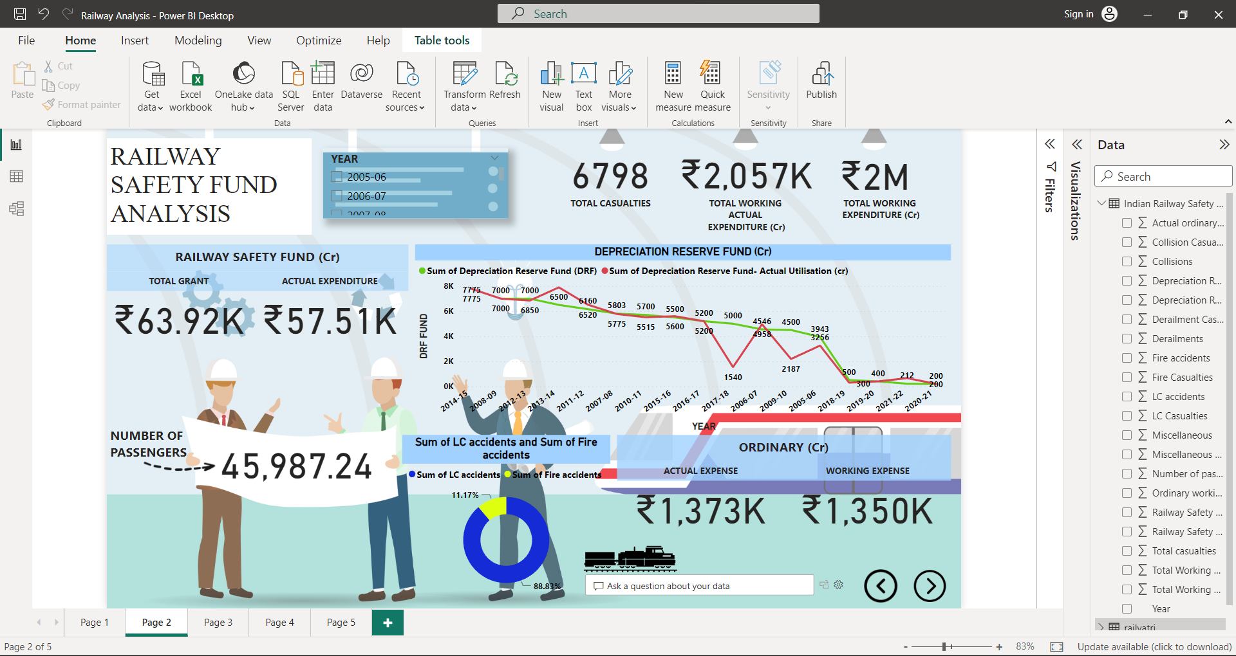
My project

Slide 11
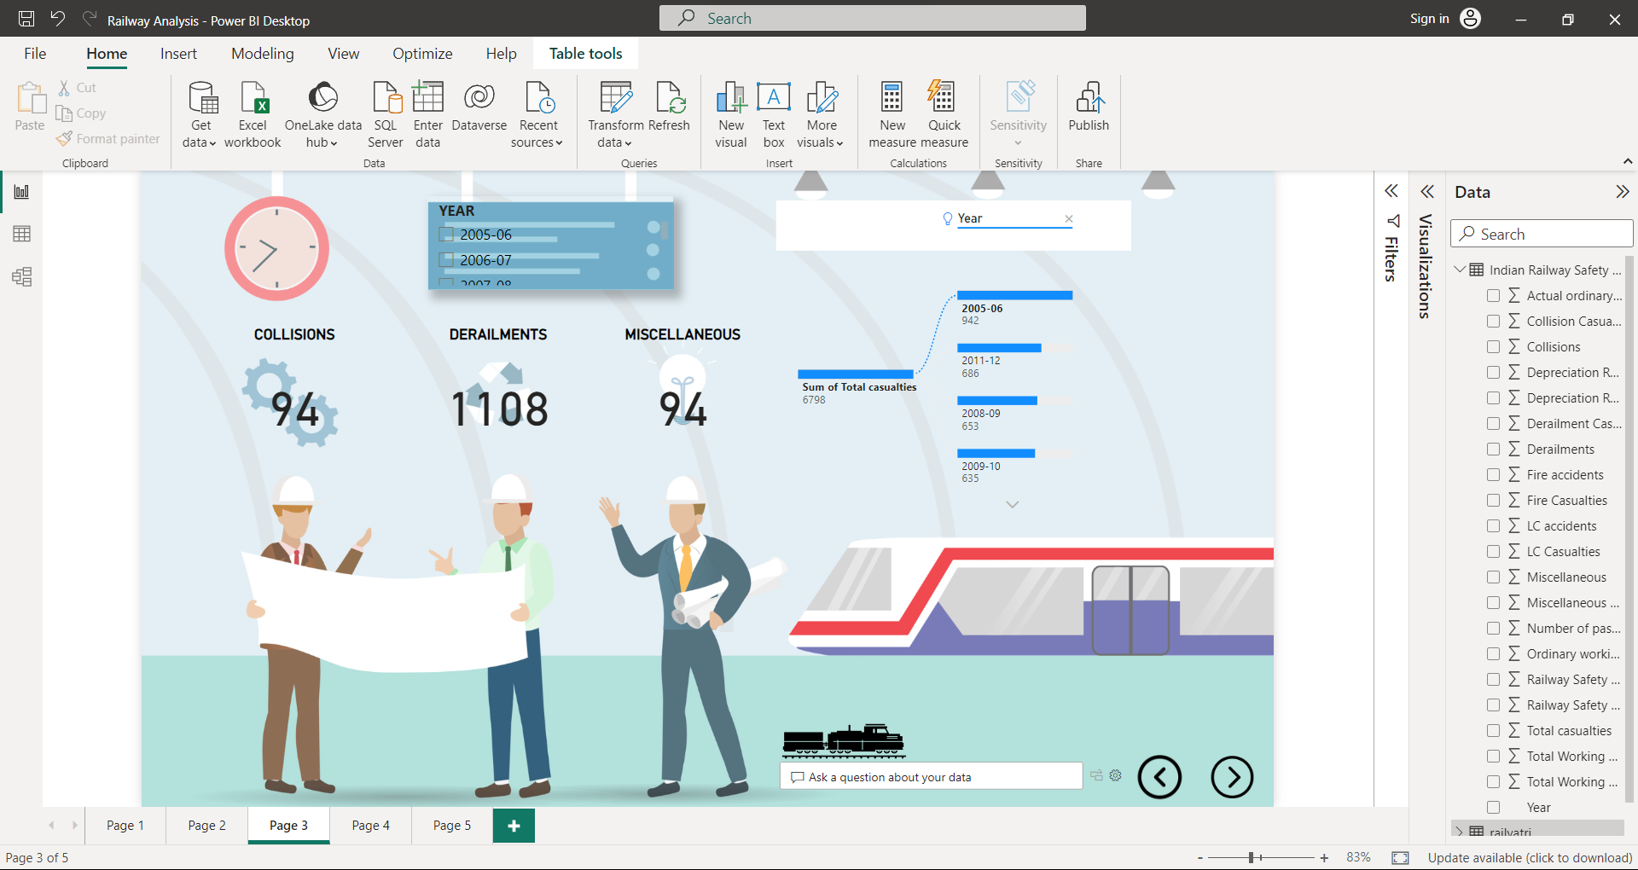
My project

Slide 12
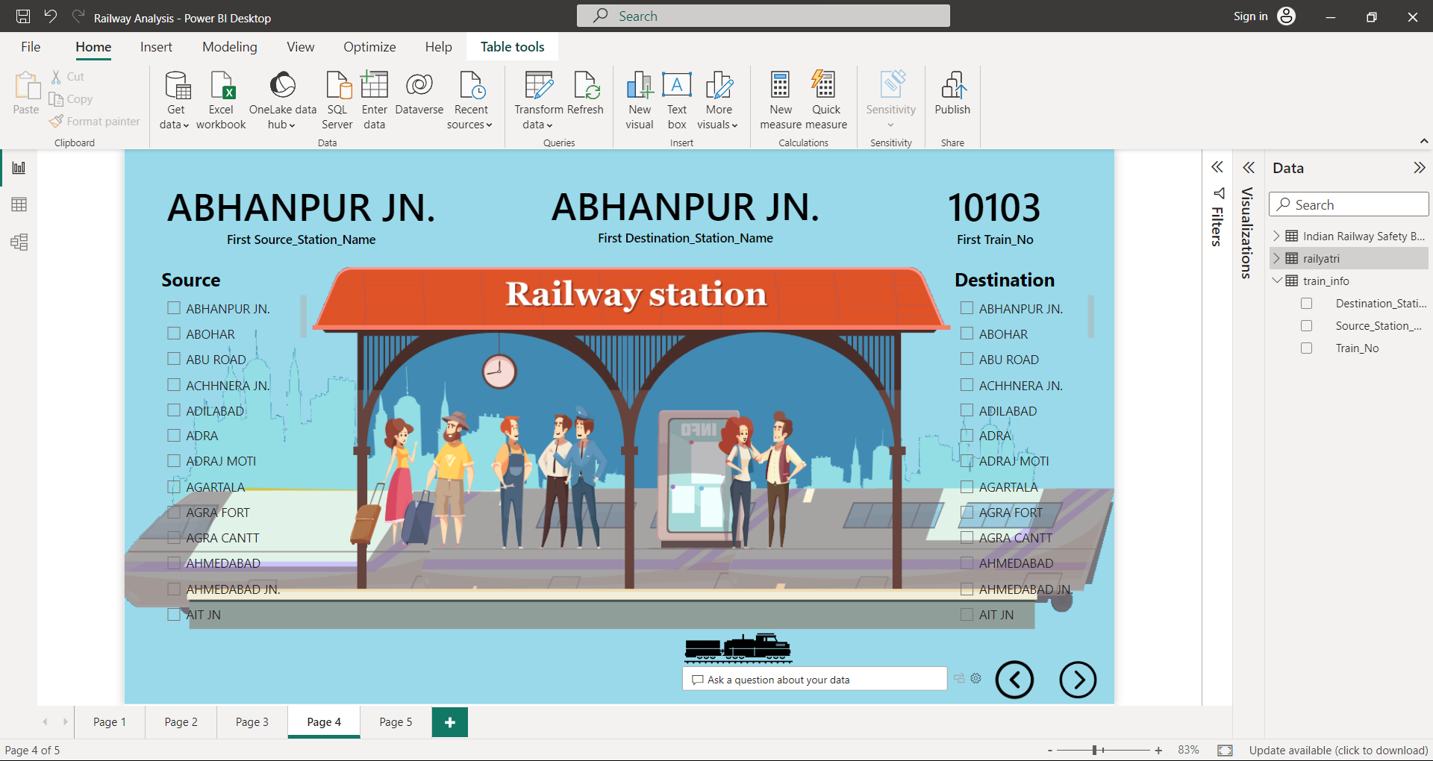
My project

Slide 13
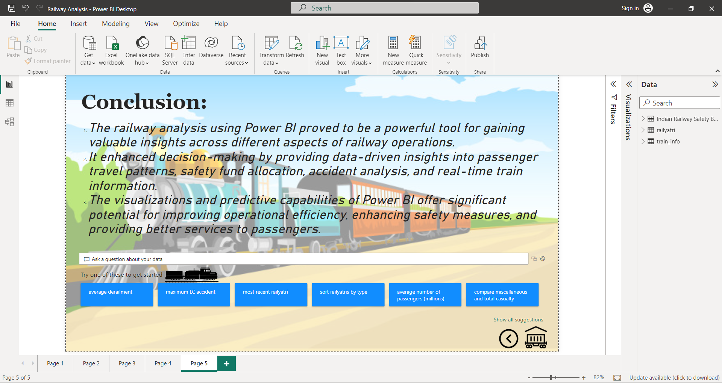
My project

Slide 14

Your turn to interview me
What questions would you like to ask me?

Slide 15
Slide Tite
Thank You!

